Slide 1


β⁻decay half-lives using the ANN model:
Input for the r-process
N. J. Costiris†, E. Mavrommatis†, J. W. Clark‡ and K. A. Gernoth§
† Department of Physics, Section of Nuclear & Particle Physics, University of Athens, 15771 Athens, Greece
‡ McDonnell Center for the Space Sciences and Department of Physics, Washington University, St. Louis, Missouri 63130, USA
§ School of Physics & Astronomy, Schuster Building, The University of Manchester, Manchester, M13 9PL, United Kingdom

Slide 2
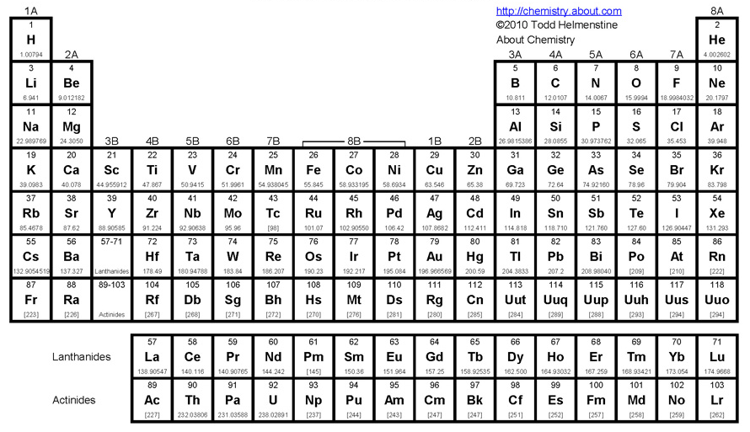
Origin of the Elements
Almost all of the H, He along with some of the Li in nature was created in the first three minutes after the Big Bang.
Two more light elements, Be and, B are synthesized in interstellar space by collisions between cosmic rays and gas nuclei (spallation).
The rest elements up to ⁵⁶Fe, are formed by exothermic fusion reactions inside stellar cores.
The heavier elements, beyond Fe are almost exclusively formed in
n-capture processes (i.e. r,s, ...), avoi-
ding Coulomb barrier and endothermic
reactions (Q-values<0).
「B²FH ^{「１」}, Cameron^{「2」} - 50 years ago」
The superheavy elements are
produced via spontaneous fission.
Periodic Table
of the Elements
「１」 E. M. Burbidge, G. R. Burbidge, W. A. Fowler, and F. Hoyle, Rev. Mod. Phys. 29, 547 (1957)
「2」 A. G. W. Cameron, Chalk River Lab. Rep. CRL-41, A.E.C.L. No. 454, Ontario (1957)

Slide 3
The R-Process Nucleosynthesis
R → Rapid neutron-capture
T~1-2 GK, n_{n}~10²⁰-10²⁶ /cm³
Density: 300 g/cm3 (~60% neutrons !)
n-capture timescale (τ_{n}): ~ 0.2 μs
τ_{n} << τ_{β}-
Neutron number
_{Z+1} ^{A}X_{N-1}
Rapid neutron
capture
β⁻-decay
Proton number
Seed
_{Z}^{A}X_{N}
^{A+1}_{Z}X_{N+1}
(n,γ)/(γ,n) equilibrium
“waiting point”
(γ,n) photodisintegration
The rapid n-capture process (r-process) is today understood to be responsible for the synthesis of about half of all the nuclei abundances present in Solar System matter in the mass region from approximately Zinc through the Actinides (e.g., Thorium, Uranium, and Plutonium), as well as the bulk of the heavy elements in the mass region A ≥ 60 in our Galactic and Cosmos matter.
R-process still remains one of the most challenging open questions in modern nuclear astrophysics, since both the astrophysical scenarios where this process occurs and the needed nuclear physics input have not yet been unambiguously identified.

Slide 4


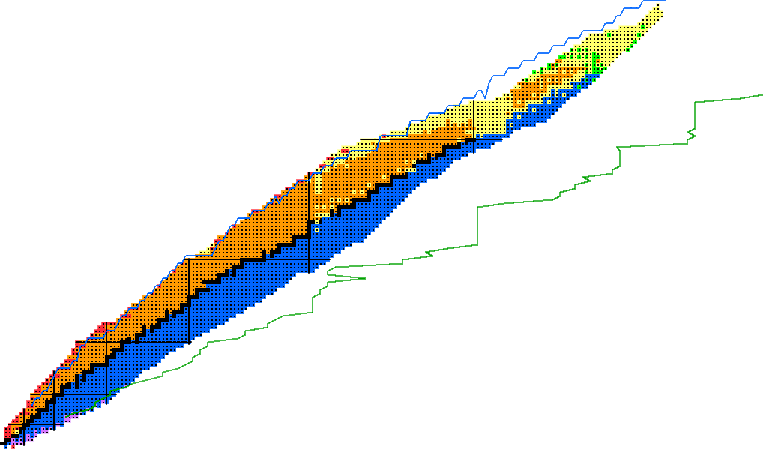
R-Process Path
chart of nuclides
?
R-process
Estimated Neutron Drip Line
FRDM (P. Möller et al. At. Data And Nucl.
Data Tables 59 (1995) 185)
n- captures must occur much faster than β⁻-decays far from stability → the r-process “runs up” along the neutron drip line.

Slide 5
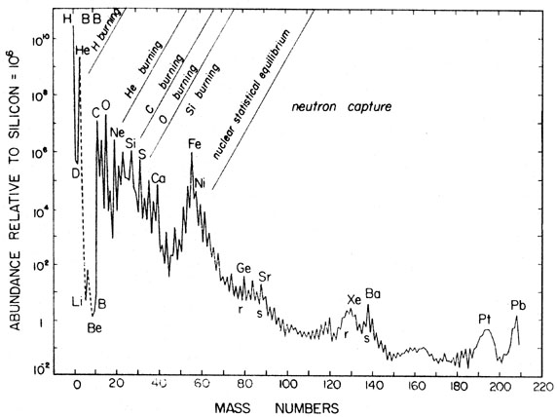
Relative Solar System Abundances
N=50
N=82
N=126
The solar elemental abundance distribution beyond Fe, shows peaks near A = 80, 130, and 195, corresponding to progenitors with closed neutron shells N = 50, 82, and 126.

Slide 6
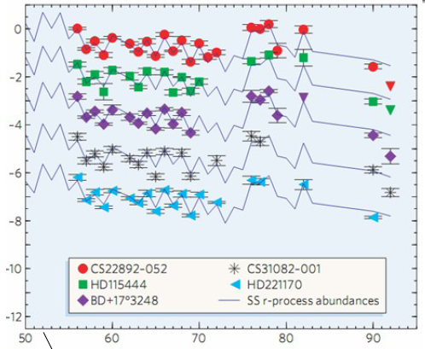
Old Metal Poor Galactic Halo Stars
The r-process operating over the history of the Galaxy
→ R-process is unique in nature!

Slide 7
Understanding of R-Nucleosynthesis
r-abundances reproduction
NUCLEAR ASTROPHYSICS.
Astrophysical Conditions
temperature (T₉) matter density
neutron density (n_{n}) …
radiation entropy (S_{rad}) r-process duration (τ_{r})
Nuclear Physics Input
nuclear-masses (Q_{β}, S_{n}) β-decay properties (T_{1/2}, P_{n}）
n-capture rates fission properties
neutrino interactions nuclear-structure-properties (J^{π} …)
for 1000’s of isotopes FAR-OFF β-stability

Slide 8
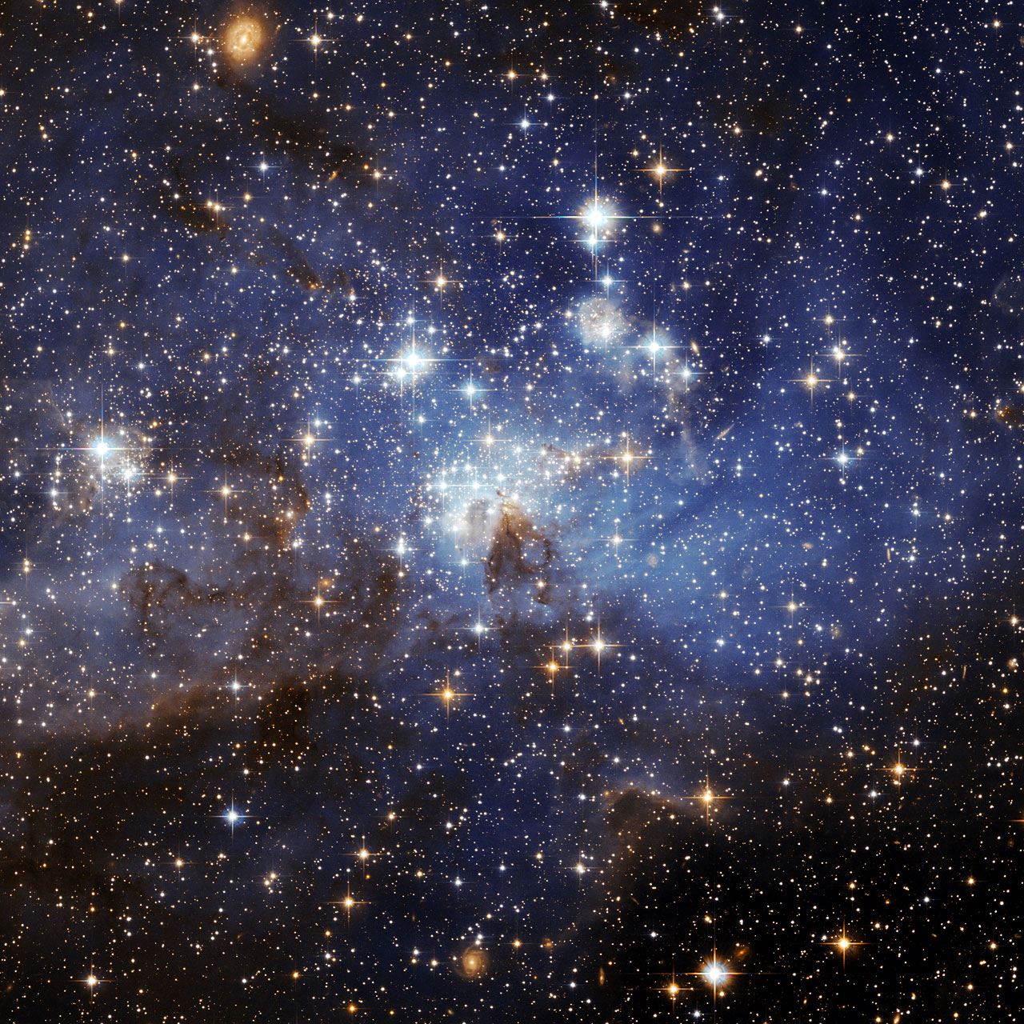

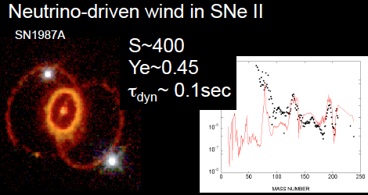
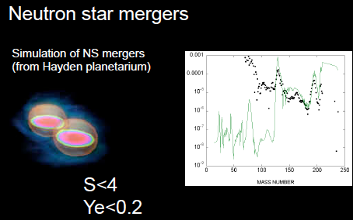
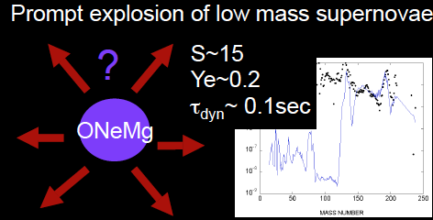
Astrophysical Site（s）
Dominant Candidates
for the “main” r-process
The most widely believed candidate site for the r-process are core-collapse supernovae (spectral Type Ib, Ic and II), which provide the necessary physical conditions for the r-process. However, the abundance of r-process nuclei requires that either only a small fraction of supernovae eject r-process nuclei to the interstellar medium, or that each supernova ejects only a very small amount of r-process material. A recently proposed alternative solution is that neutron star mergers (a binary star system of two neutron stars that collide) may also play a role in the production of r-process nuclei, but this has yet to be observationally confirmed.
If nuclear physics uncertainties are reduced, we could indentify astrophysical site via observations.

Slide 9
Understanding of R-Nucleosynthesis
r-abundances reproduction
NUCLEAR ASTROPHYSICS.
Astrophysical Conditions
temperature (T₉) matter density
neutron density (n_{n}) …
radiation entropy (S_{rad}) r-process duration (τ_{r})
Nuclear Physics Input
nuclear-masses (Q_{β}, S_{n}) β-decay properties (T_{1/2}, P_{n}）
n-capture rates fission properties
neutrino interactions nuclear-structure-properties (J^{π} …)
for 1000’s of isotopes FAR-OFF β-stability

Slide 10

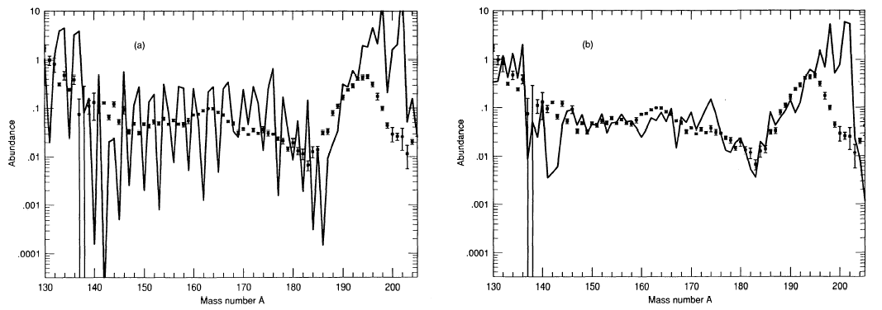
Nuclear Physics Input
T_{1/2} of very neutron-rich nuclei
Nuclear masses
S_{n}-values ⇒r-process paths (i.e. S_{n} ~ 3 MeV)
β-decay properties
β⁻ Half-lives⇒ duration – speed – time scale
⇒ r-process clock
T_{1/2} (g.s., is.) ⇒ r-process progenitor abundances (N_{r,prog})
T_{1/2} of waiting points ⇒ pre freeze-out isobaric abundances and regulate the speed of the process towards heavier elements.
T_{1/2} of heavy neutron-rich radionuclides ⇒ time scale for the matter flow from the r-process seeds to even heavier nuclei.
Sum of T_{1/2} ⇒ total r-process duration (τ_{r})
β-delayed n-emission branching probabilities
P_{n} ⇒ smoothing N_{r,prog} → N_{r,final} (N_{r,})

Slide 11
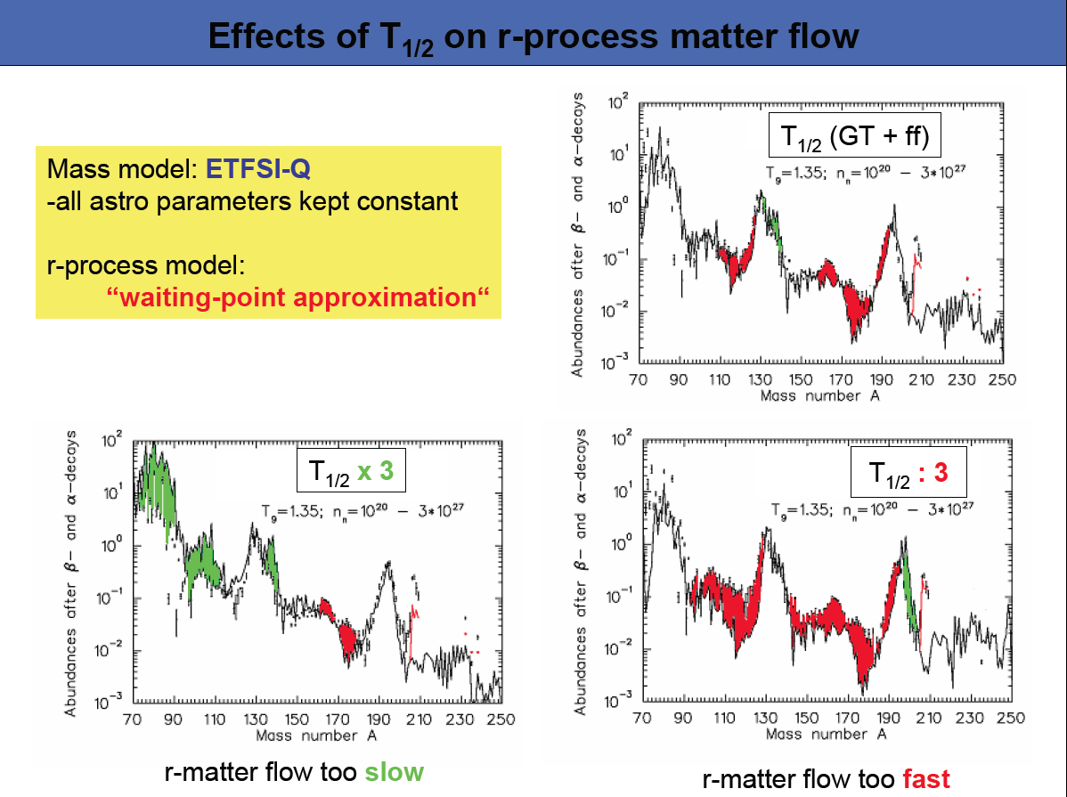
Effects of T_{1/2} on matter flow
K.-L. Kratz, 7th Workshop on Nuclear Astrophysics, Russbach 2010

Slide 12
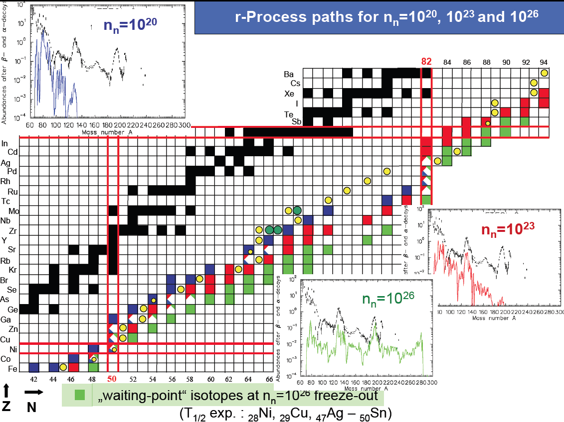
Today’s Exp. Info - R-process paths
Today, altogether 60 r-process nuclei are only known!
Heaviest isotopes with measured T_{1/2}
new (MSU, 2009)
“Waiting point” isotopes at:
n_{n} = 10²⁰
n_{n} = 10²³
n_{n} = 10²⁶
freeze-out networks.
K.-L. Kratz, 7th Workshop on Nuclear Astrophysics, Russbach 2010
The r-process should be a dynamical process with continuously altered conditions and paths.

Slide 13
β⁻-decay Half-lives Approaches
GT
GT2
SGT
GT*
Shell Model
FRDM + pnQRPA
QRPA + ffGT
Theory-driven
HFBSC + CQRPA
C-QRPAs
ETFSI+CQRPA
DF3+CQRPA
R-QRPAs
R-QRPA+ff

Slide 14

Statistical Modeling
Learning Machines
Data- driven
Artificial Neural Networks (ANNs)
Support Vector Machines (SVMs)
Ref: V. N. Vapnik, Statistical Learning Theory, Wiley-Interscience , 1998.

Slide 15
To what extend can mature learning machines (i.e. ANNs) decode the underlying β-decay half-lives systematics by only utilizing the hidden information over the minimal input of the Z and N nucleonic numbers?
Statistical Modeling Using ANNs
data-driven, stand-along statistical approaches
Fundamental Question

Slide 16
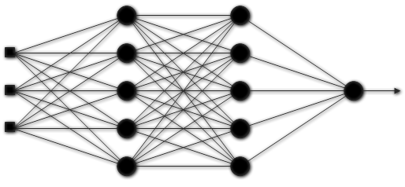
Artificial Neural Networks
Learning Machines
classification – function approximation
Fully-connected Feed-forward Neural Network
Input Neurons
Hidden Intermed. Layers
Output Neuron

Slide 17
Objective: minimization of cost function
Machine learning statistical framework
target
(Log₁₀T_{β,exp})
Back-propagation
Learning Procedure
input
[Z,N,δ]
Neural Network
with C weights
Output
(Log₁₀T_{β,calc})
comparison
weights adjustment
Levenberg-Marquardt BP update rule

Slide 18
The ANN Model
General ANN Model Features
Network | Architecture |  | Activation Functions
Feed-forward Fully-connected | Size: | 3-5-5-5-5-1 | tanh-tanh-tanh-tanh-satlins
 | Weights: | 116
Mode | Training Algorithm | Initialization Method
Batch | Bayesian Regularization | Nguyen-Widrow
Input Scaling [-1, 1] |  | Output Scaling [-1, 1] |  | Max Fail
Z | [0, 230] | Log₁₀T_{1/2} (ms) | [0.18 - 8.98] | 300 epochs
N | [0, 230]
Parity | [-1, 1]
N. J. Costiris, E. Mavrommatis, K. A. Gernoth, and J. W. Clark, Phys. Rev. C80, 044332 (2009)

Slide 19
Database | Half-life Range | Decay Mode | NuSet-B
NuBase2003 * | 0.15 ^{χ} 10⁻² s → ³⁵Na 2.43 ^{χ} 10²³ s → ¹¹³Cd | 100% β⁻ | Cutoff | 10⁶ s
* A.H. Wapstra, G. Audi et al., Nucl Phys. A729 (2003) 337
To avoid overfitting effects
Early Stopping
Training Set | Validation Set | Test Set
NuSet-B. Uniform Nuclides Distribution over Half-lives
All Nuclides | Training Set (60%) | Validation Set (20%) | Test Set (20%)
843 | 503 | 167 | 168

Slide 20
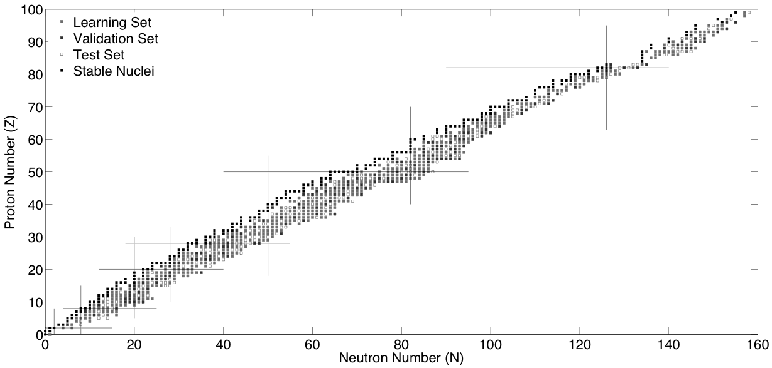
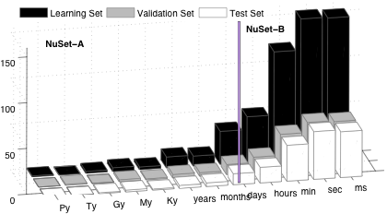

Slide 21
ANN Performance
Set | RMSE
fact | T_{1/2} Exp (s) | Overall Mode |  |  | NBSC+pnQRPA
 |  | m(%) | <x>_{K} | σ_{K} | m(%) | <x>_{K} | σ_{K}
<10 | <10⁶ | 90.5 | 2.46 | 1.72 | 76.7 | 3.00 | -
 | <60 | 96.5 | 2.21 | 1.52 | 87.2 | 2.81 | -
 | <1 | 97.6 | 2.10 | 1.39 | 95.7 | 2.64 | -
<2 | <10⁶ | 53.5 | 1.41 | 0.27 | 33.8 | 1.43 | -
 | <60 | 60.6 | 1.41 | 0.27 | 42.0 | 1.41 | -
 | <1 | 61.9 | 1.41 | 0.26 | 50.7 | 1.43 | -
Learning | 0.53
Validation | 0.60
Test | 0.65
Overall | 0.57
N. J. Costiris, E. Mavrommatis, K. A. Gernoth, and J. W. Clark, Phys. Rev. C80, 044332 (2009)

Slide 22
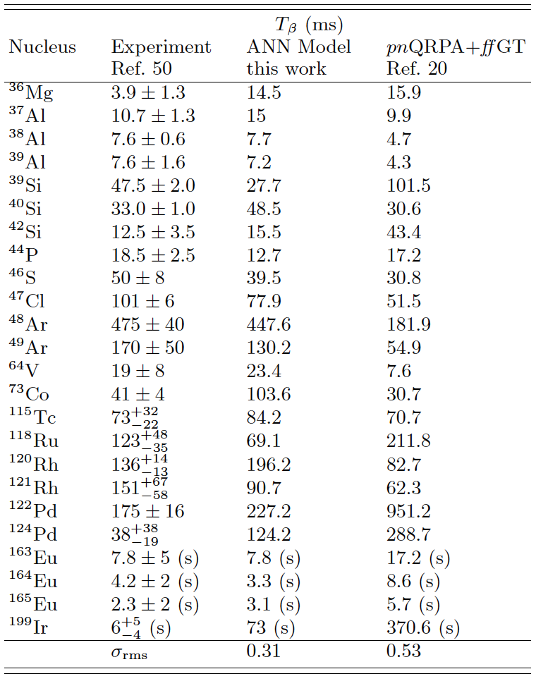
Results
Recently measured T_{β} for very neutron-rich nuclides.

Slide 23
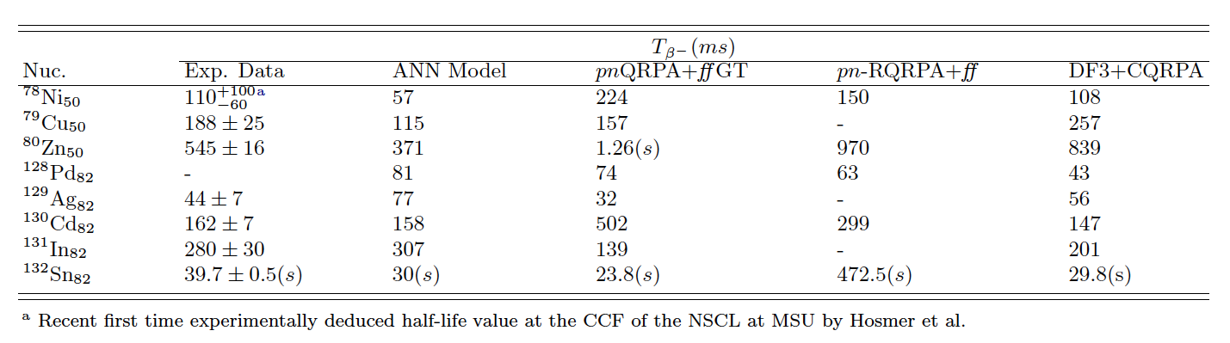
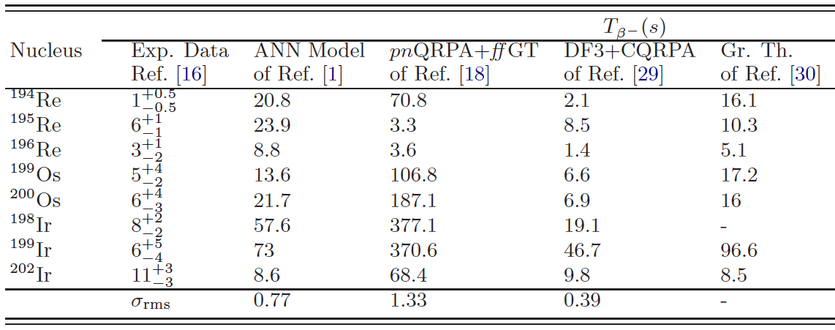
Relevant to R-process Results
Some r-process waiting-point nuclei at N = 50 and N = 82 regions.
Recently measured* T_{β} of eight heavier abuse to ff neutron-rich
isotopes close to the neutron shell N = 126 around A = 195.
*T. Kurtukian-Nieto et al.

Slide 24
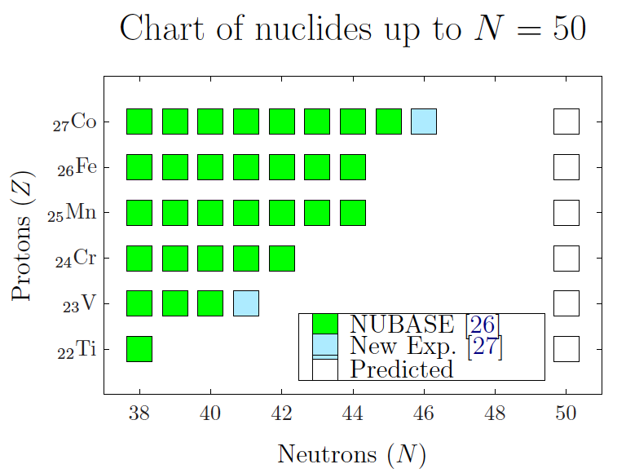
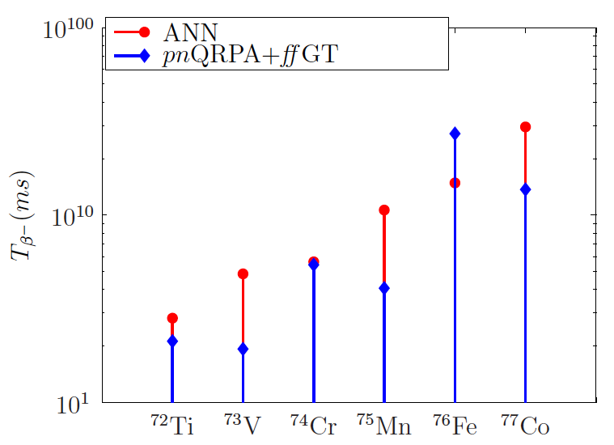
N=50 Closed Shell
A = 70 − 80 mass region

Slide 25
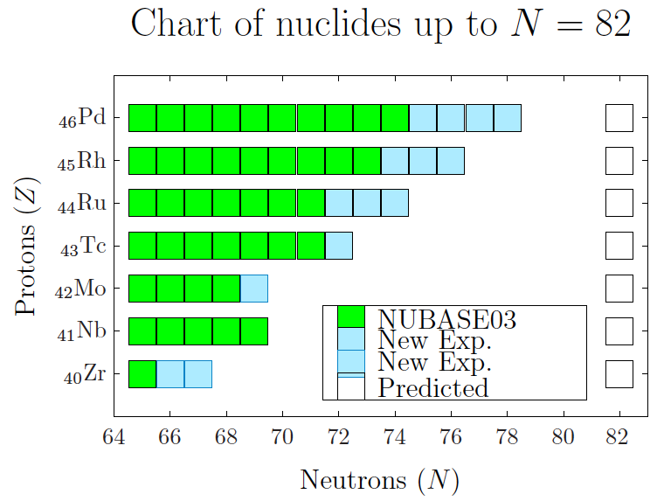
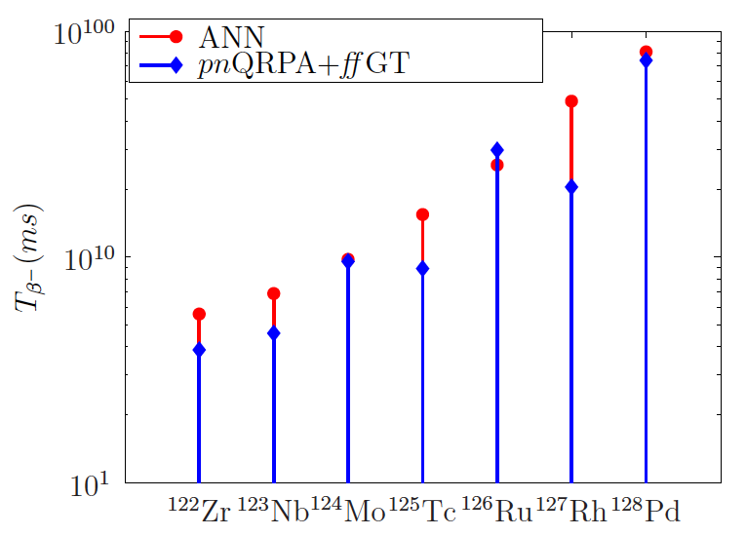
N=82 Closed Shell
A = 120 − 130 mass region

Slide 26
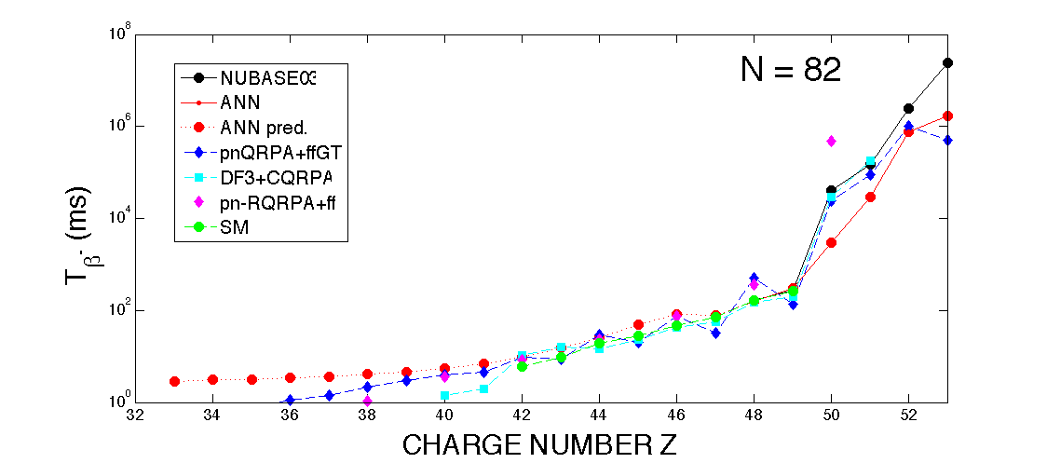
N=82 Isotonic Chain

Slide 27
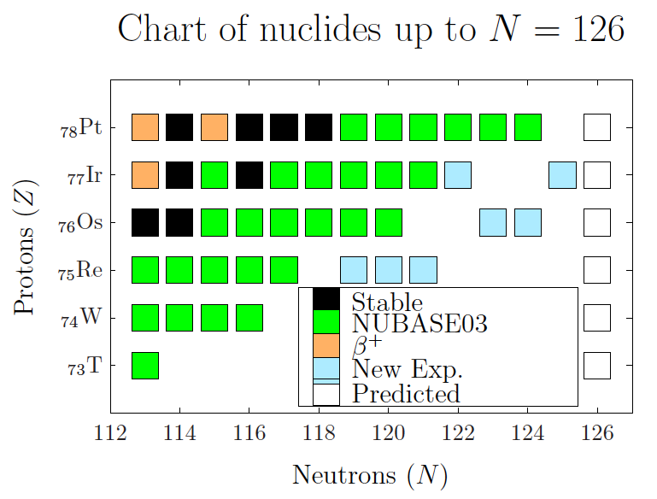
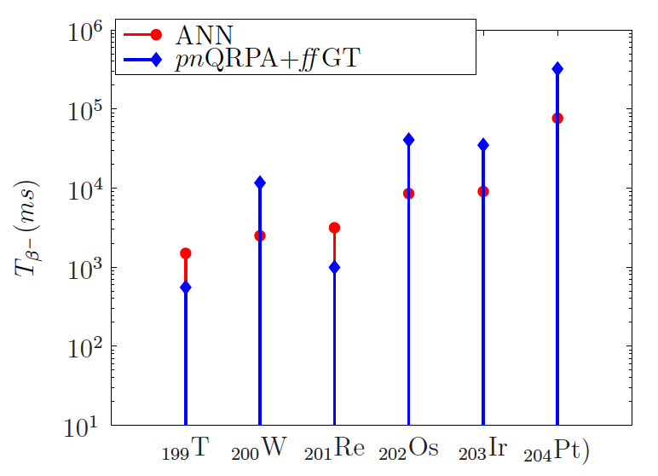
N=126 Closed Shell
A = 195 − 205 mass region

Slide 28
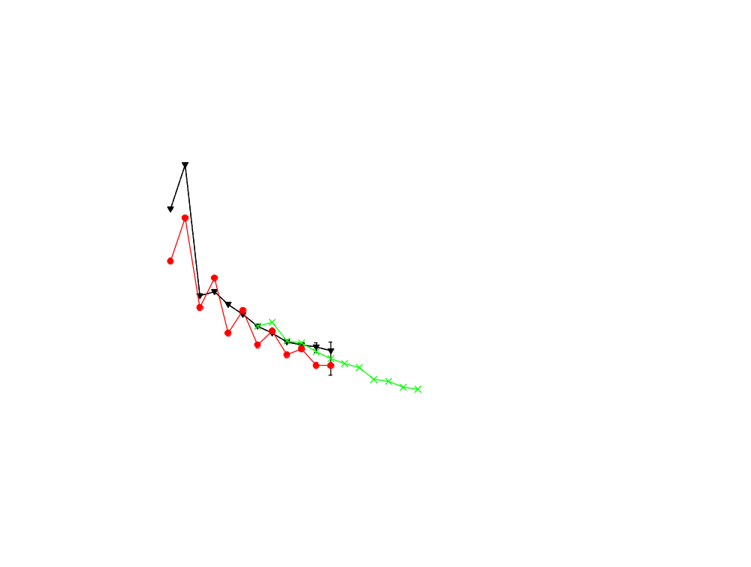
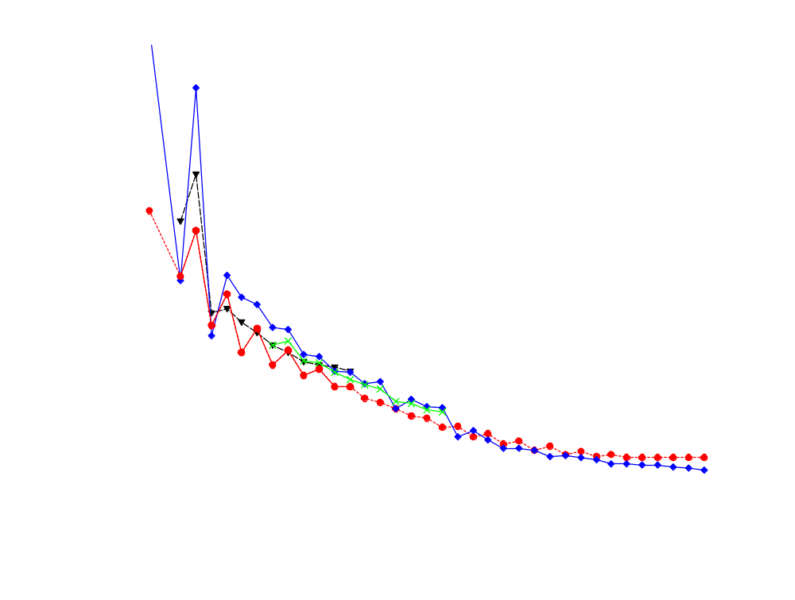
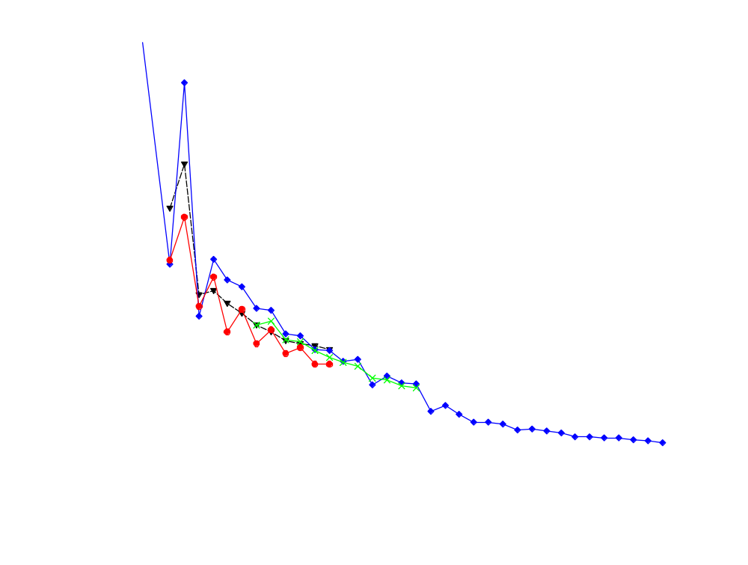
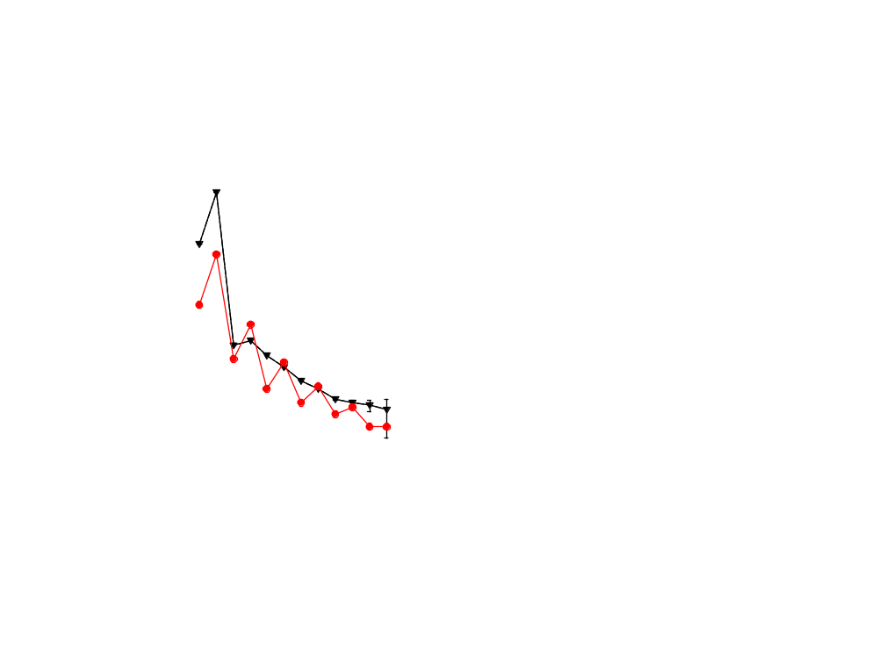
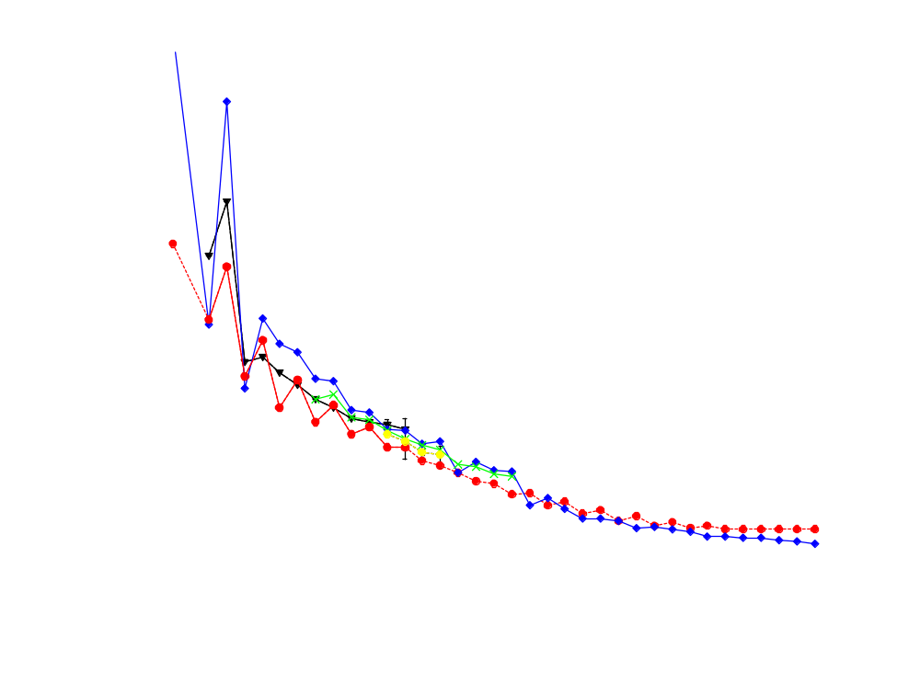
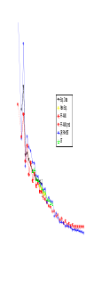
Isotopic Chain οf ₂₈Ni
Exp. Data
New Exp.
FF-ANN
FF-ANN pred.
QRPA + ffGT
GT*

Slide 29
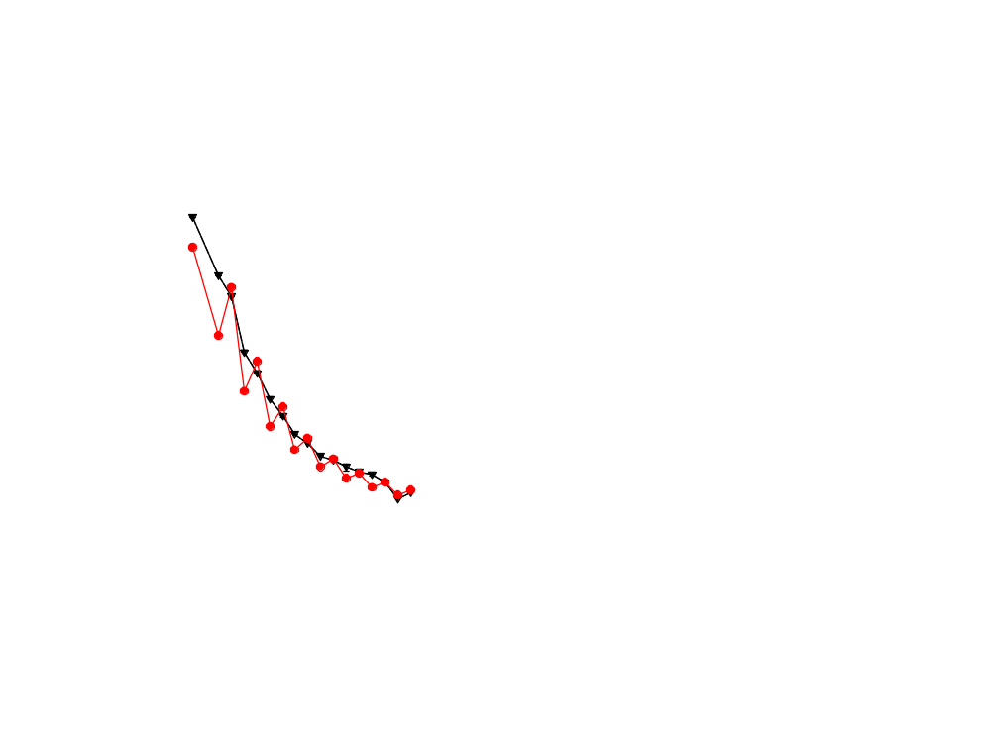
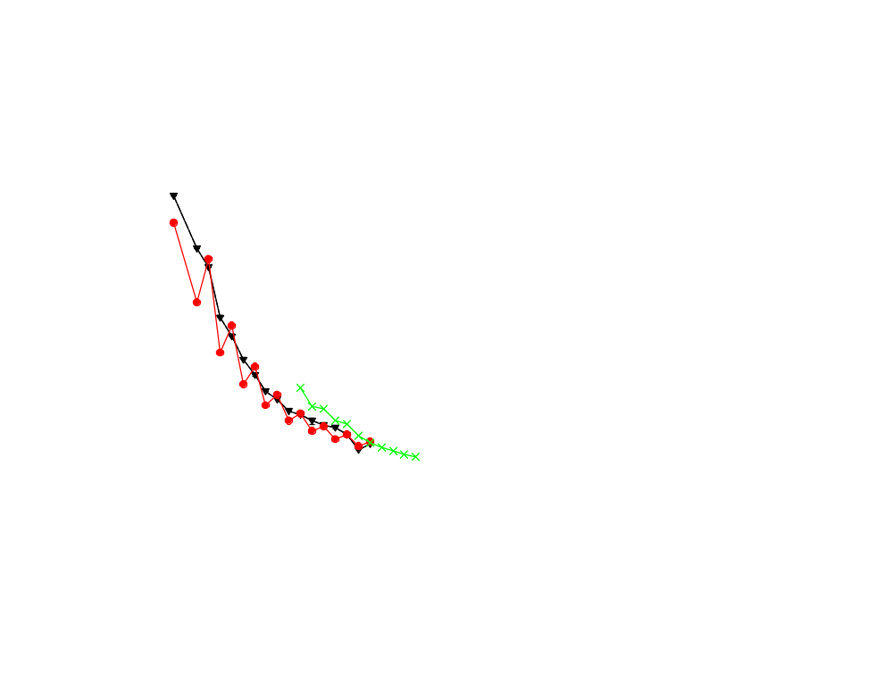
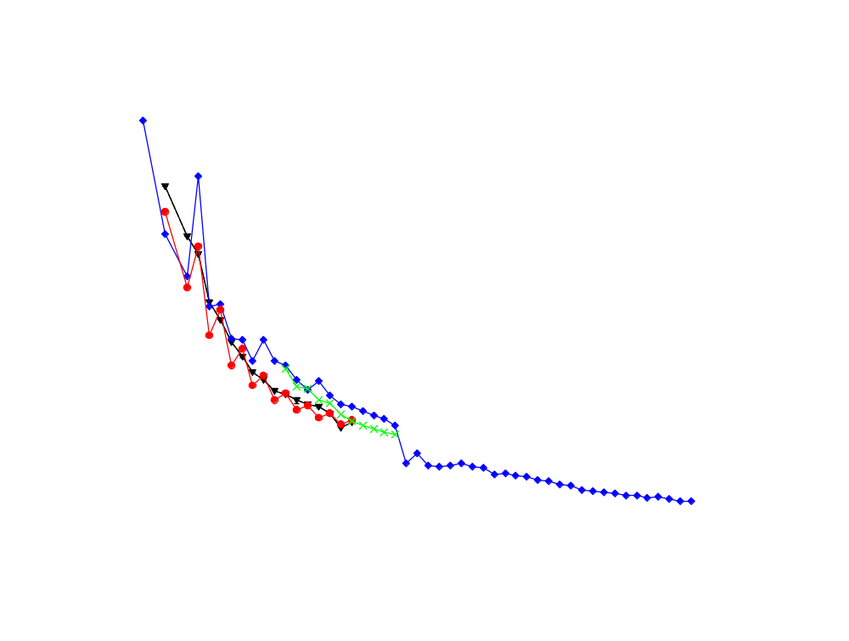
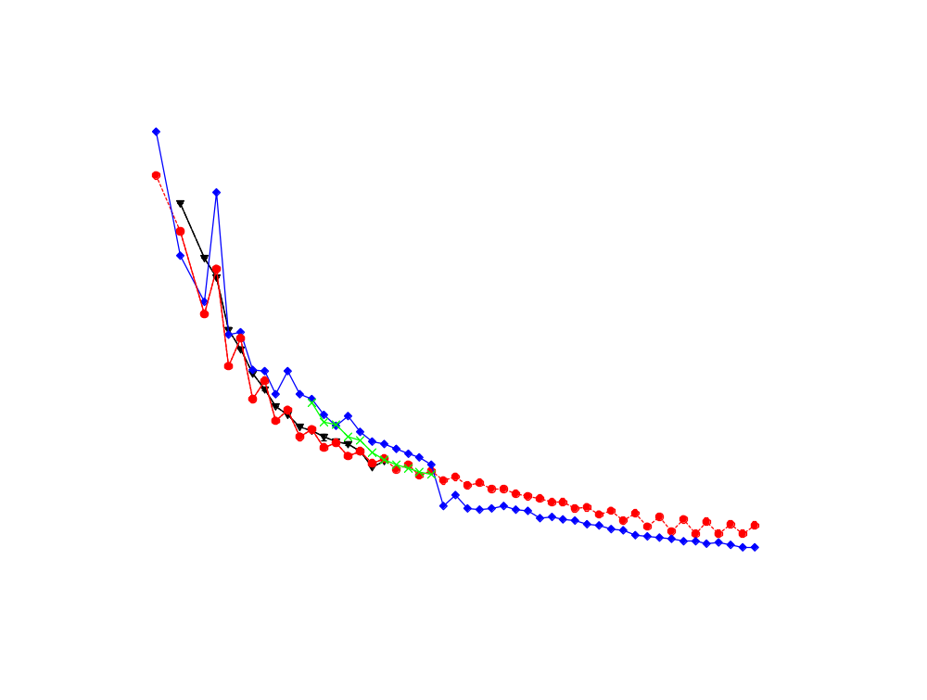
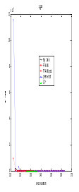
Isotopic Chain of ₄₈Cd
Exp. Data
FF-ANN
FF-ANN pred.
QRPA + ffGT
GT*

Slide 30
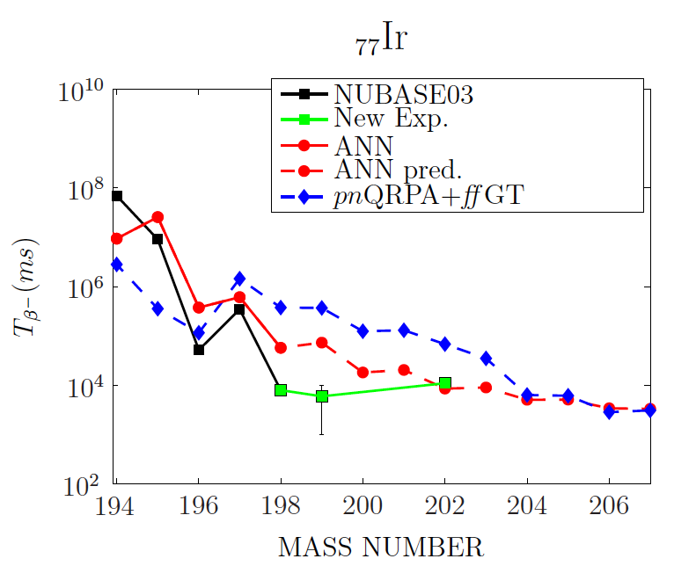
Isotopic Chain of ₇₇Ir

Slide 31
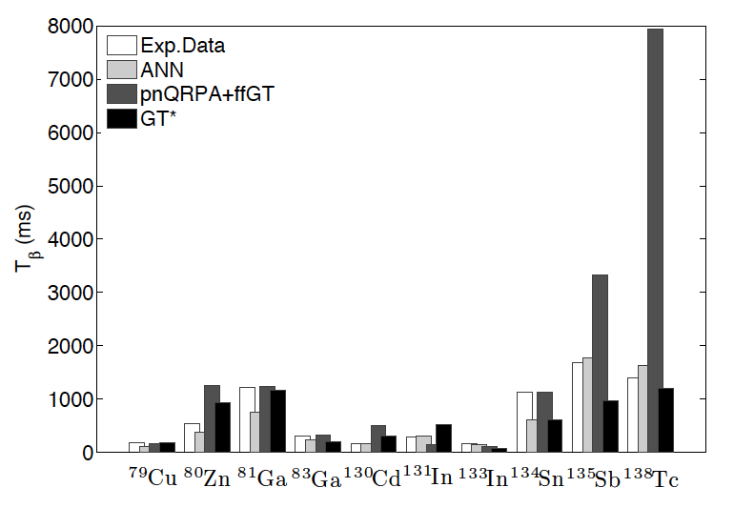
Nuclides on or near a typical r-process path
with S_{n} up to 3 MeV

Slide 32






New data will help enormously
Radioactive Ion Beam Facilities Timeline
HIE-ISOLDE
ISOLDE
ISAC-II
ISAC-I
SPIRAL2
SPIRAL
FAIR
SIS
RIBF
RARF
NSCL
HRIBF
In Flight
ISOL
Fission+Gas Stopping
CARIBU@ATLAS
FRIB
Beam on target
2000
2005
2010
2015
2020

Slide 33
Conclusions & Prospects
Conclusions
Theory-thin statistical global models of nuclear properties developed by learning machines should provide a valuable, robust additional tool to complement the nuclear systematics studies beyond the standard nuclear landscape planned with the present and future very neutron- rich, rare-isotope experimental facilities.
Prospects
We plan further studies of nuclear properties relevant to r-process: masses, neutron capture cross-sections with the already developed by us ANN and SVM techniques.
We also plan further studies of nuclear properties using Artificial Intelligence‘s more mature learning strategies, such as committee of machines (CoM) - a collection of different feed-forward Artificial Neural Networks (ANNs) instead of a single ANN, with a view to refine current results.

Slide 34
Thank You
Questions
？
β⁻decay half-lives using the ANN model:
Input for the r-process*
N. J. Costiris†, E. Mavrommatis†, J. W. Clark‡ and K. A. Gernoth§
† Department of Physics, Section of Nuclear & Particle Physics, University of Athens, 15771 Athens, Greece
‡ McDonnell Center for the Space Sciences and Department of Physics, Washington University, St. Louis, Missouri 63130, USA
§ School of Physics & Astronomy, Schuster Building, The University of Manchester, Manchester, M13 9PL, United Kingdom
*To be submitted to Phys. Rev. C
URL: http://www.pythaim.phys.uoa.gr
E-mail: pythaim@phys.uoa.gr

Slide 35
Backup Slides

Slide 36
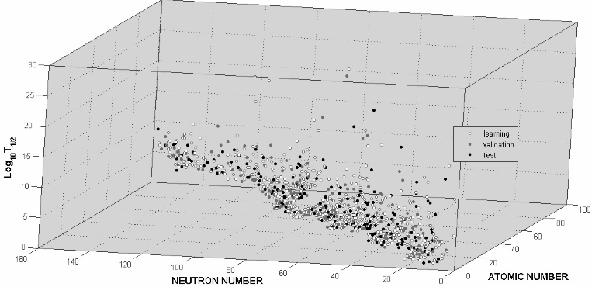
NuBase03

Slide 37
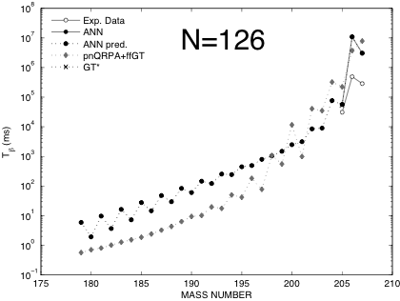
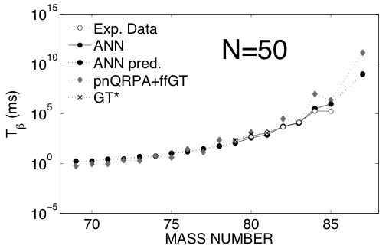
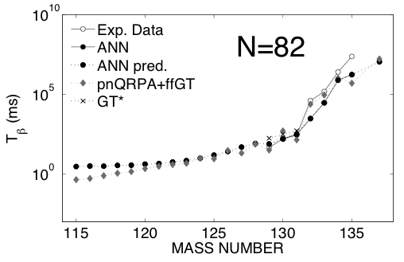
Isotonic Chains

Slide 38
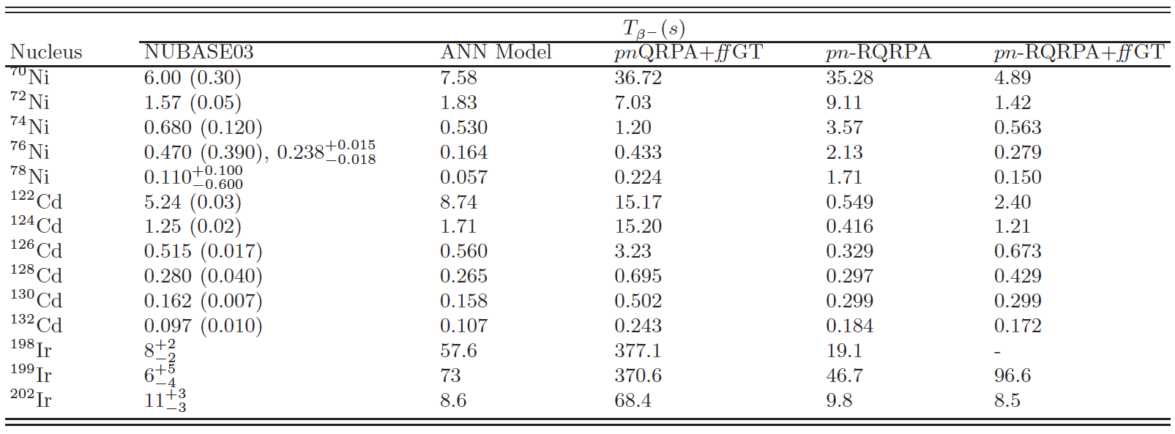

Slide 39
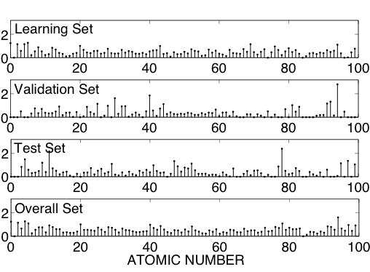
RMSE

Slide 40
Klapdor’s Metrics*
* H. Homma, M. Bender et al., Phys. Rev. C 54:6 (1996) 2972
fact | T_{1/2} Exp (s) | Overall Mode |  |  | Prediction Mode |  |  | NBSC+pnQRPA
 |  | m(%) | <x>_{K} | σ_{K} | m(%) | <x>_{K} | σ_{K} | m(%) | <x>_{K} | σ_{K}
<10 | <10^6 | 90.5 | 2.46 | 1.72 | 90.5 | 2.69 | 1.85 | 76.7 | 3.00 | -
 | <60 | 96.5 | 2.21 | 1.52 | 96.1 | 2.48 | 1.64 | 87.2 | 2.81 | -
 | <1 | 97.6 | 2.10 | 1.39 | 98 | 2.24 | 1.30 | 95.7 | 2.64 | -
<5 | <10^6 | 82.8 | 1.99 | 0.95 | 79.2 | 2.10 | 0.97 | - | - | -
 | <60 | 90.2 | 1.88 | 0.84 | 87.3 | 2.05 | 0.91 | - | - | -
 | <1 | 93.7 | 1.88 | 0.8 | 94 | 2.04 | 0.89 | - | - | -
<2 | <10^6 | 53.5 | 1.41 | 0.27 | 49.4 | 1.48 | 0.28 | 33.8 | 1.43 | -
 | <60 | 60.6 | 1.41 | 0.27 | 53.9 | 1.48 | 0.27 | 42.0 | 1.41 | -
 | <1 | 61.9 | 1.41 | 0.26 | 60 | 1.50 | 0.27 | 50.7 | 1.43 | -
must tends towards 1 while
must tends towards 0.

