Slide 1



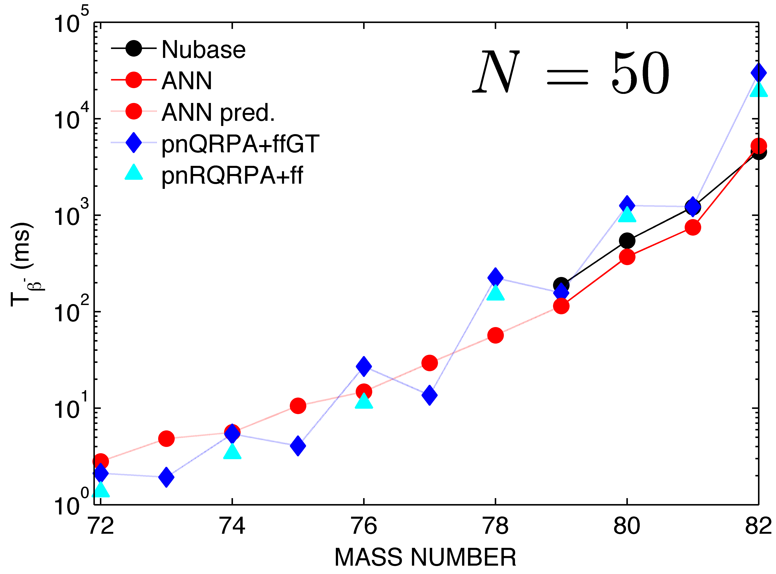
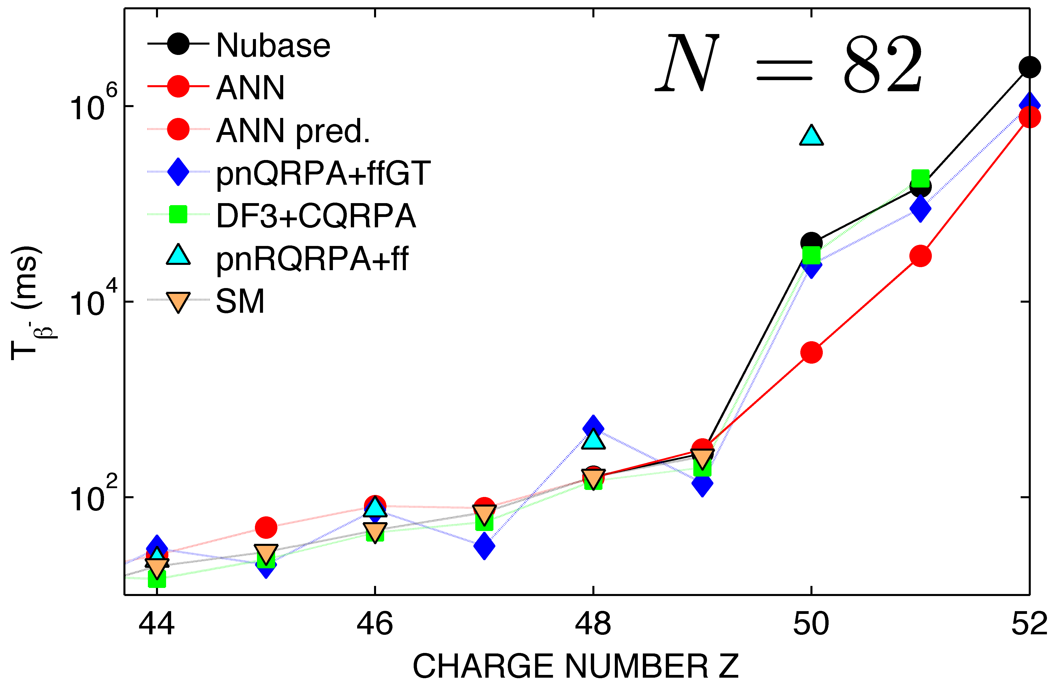
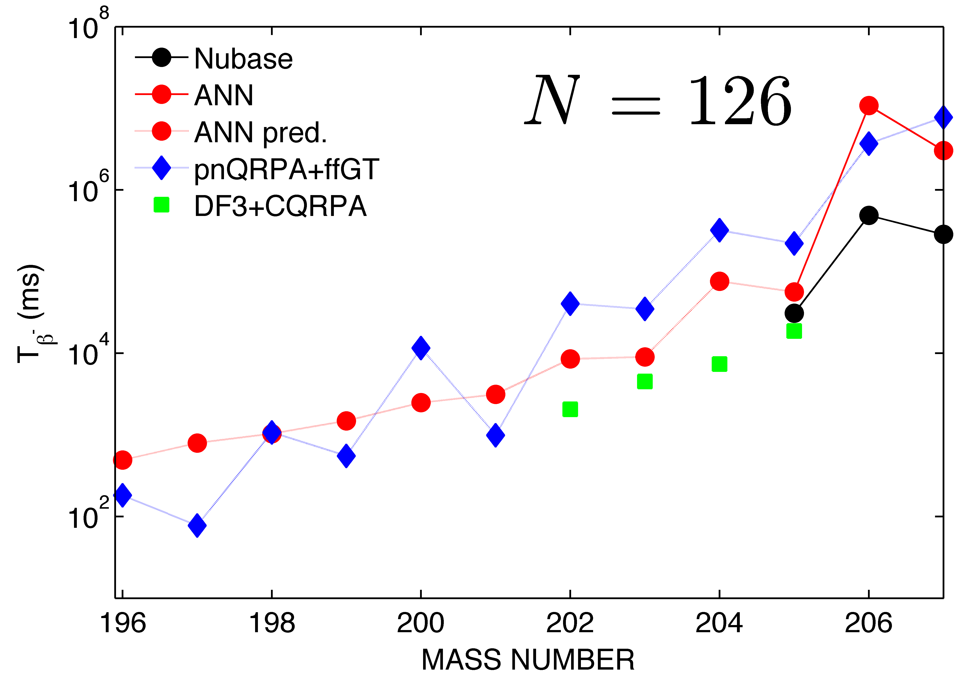

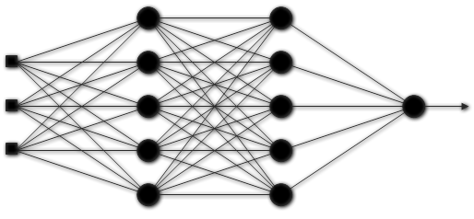
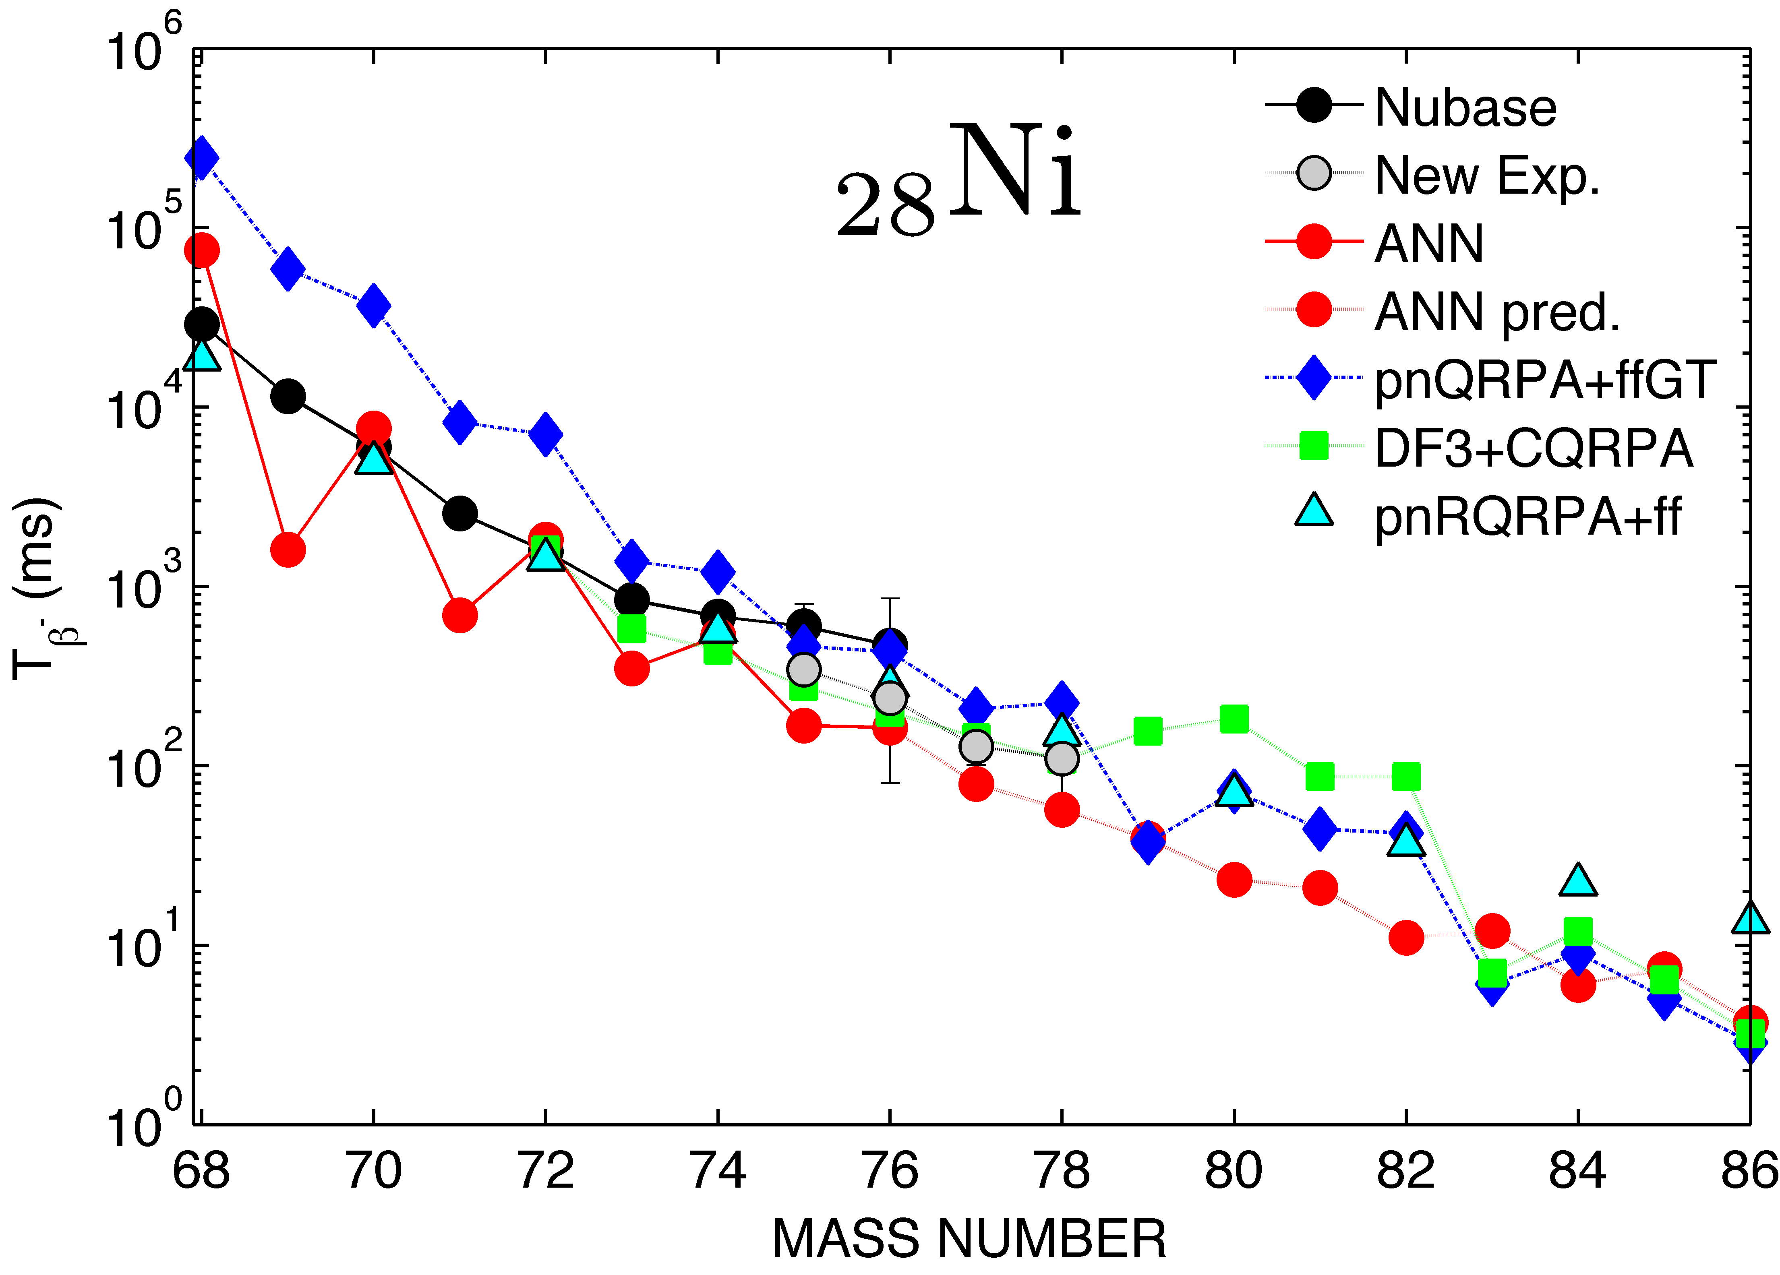
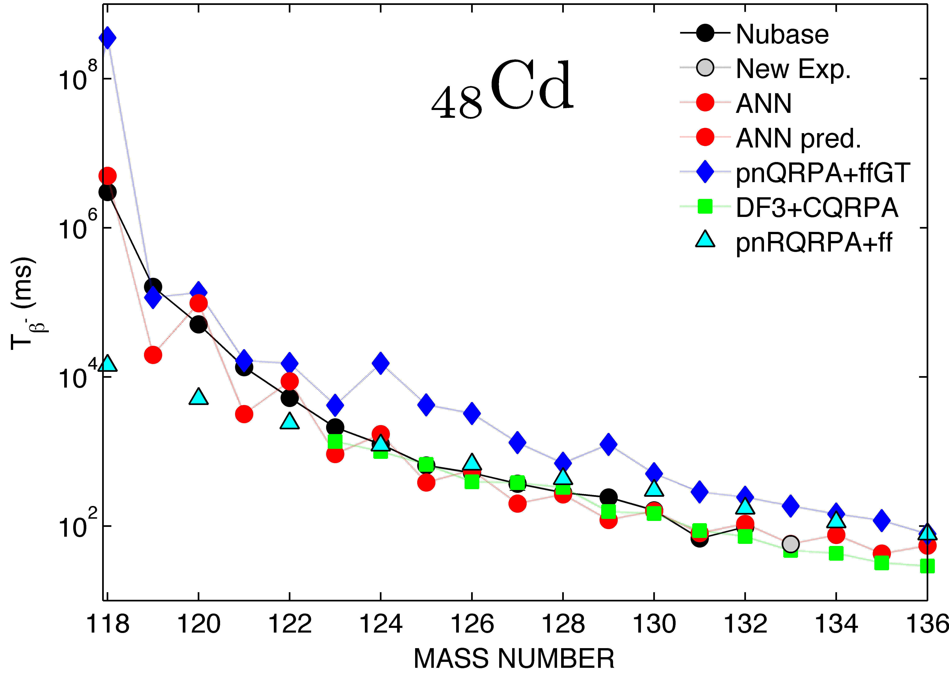

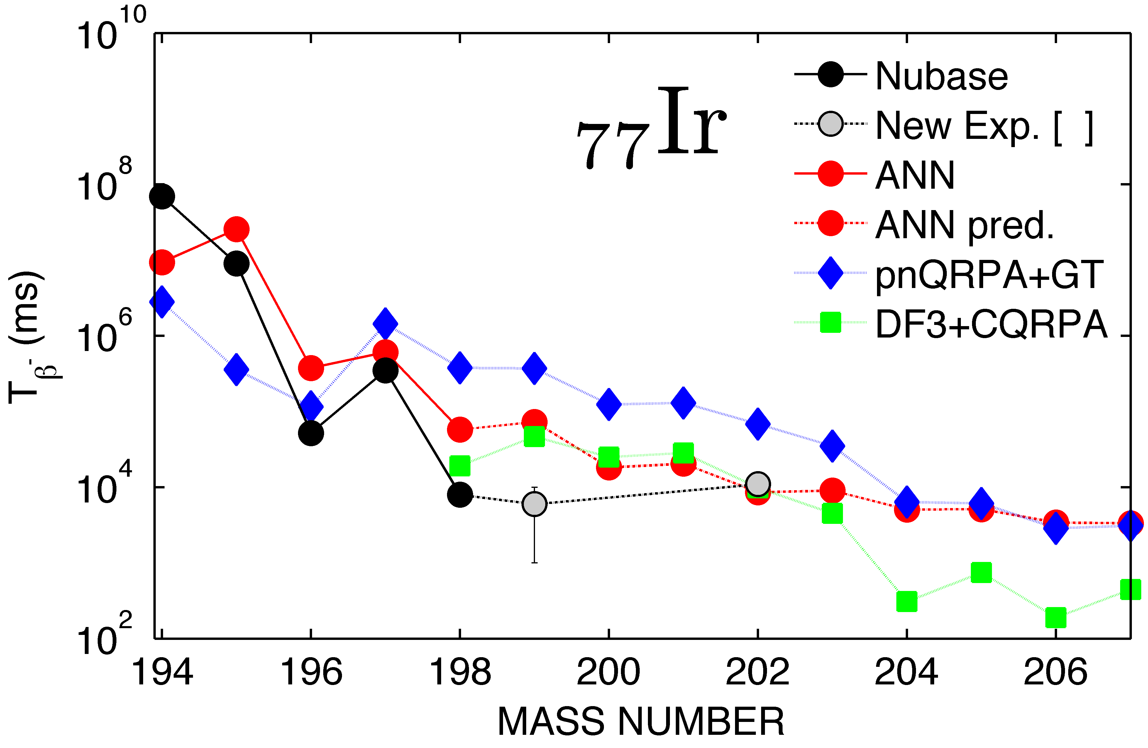
To what extent can mature learning machines (i.e. ANNs) properly decode the underlying β-decay half-lives systematics by only utilizing the hidden information inside of the minimal input Z and N nucleonic numbers?
Half-Lives for R-Process Nucleosynthesis
Using the ANN Statistical Global Model
N. J. Costiris⁽¹⁾, E. Mavrommatis ⁽¹⁾, K. A. Gernoth ⁽²⁾ and J. W. Clark ⁽³⁾
(1) Physics Department, Division of Nuclear and Particle Physics, University of Athens, 15771 Athens, Greece
(2) Department of Physics, UMIST, P.O. Box 88, Manchester M60 1QD, United Kingdom
(3) McDonnell Center for the Space Sciences and Department of Physics, Washington University, St. Louis, Missouri 63130, USA
“Numbers Rule The Universe”
Pythagoras Of Samos
http://www.pythaim.phys.uoa.gr
E-mail: pythaim@phys.uoa.gr
Introduction
Results - Comparisons
Statistical modeling of nuclear data within machine learning techniques provides a novel approach to nuclear systematics. Currently, there is an urgent need for reliable estimates of β⁻-decay half-lives of nuclei far from stability. This need is driven among others for the understanding of the r-process nucleosynthesis (mainly the element distribution and the time-scale). In this work [1], our recently developed Artificial Neural Network (ANN) statistical global model [2] of the β⁻-decay half-life systematics has been applied to the relevant to the r-process nuclei. We briefly report here our methodology and present and compare our results with the available experimental [3, 8-11] and the theory-driven values [5-7] in several regions of main interest. It seems that our new data-driven global model is very promising.
WP Nucleus | T_{β}⁻ (ms)
 | Exp. Data [3, 13] | ANN Model [2] | pnQRPA+ffGT [5] | pnRQRPA+ff [6] | DF3+ CQRPA [7]
⁷⁸Ni₅₀ | 110 (+100,-60) | 57 | 224 | 150 | 108
⁷⁹Cu₅₀ | 188 ± 25 | 115 | 157 | - | 257
⁸⁰Zn₅₀ | 545 ± 16 | 371 | 1.26 (s) | 970 | 839
¹²⁹Ag₈₂ | 44 ± 7 | 77 | 32 | - | 56
¹³⁰Cd₈₂ | 162 ± 7 | 158 | 502 | 299 | 147
¹³¹In₈₂ | 280 ± 30 | 307 | 139 | - | 201
¹³²Sn₈₂ | 39.7 ± 0.5 (s) | 3 (s) | 23.8 (s) | 472.5 (s) | 29.8 (s)
β⁻-decay half-lives (T_{β}−) for main r-process waiting-point nuclei at N = 50 and N = 82 regions as given by the ANN Model [2], in comparison with the experimental values, as well as with the pnQRPA+ffGT calculations by Möller et al. [5] and the DF3+CQRPA model by Borzov et al. [7].
Isotonic chain of N=50
ANNs - Machine Learning Procedure
Nucl. | T_{β}− (ms) |  |  | Nucl. | T_{β}− (ms)
 | Exp. [3,9-11] | ANN [2] | QRPA+ffGT [5] |  | Exp. [3,9-11] | ANN [2] | QRPA+ffGT [5]
⁷⁰Fe | 94 ± 17 | 180 | 262 | ¹¹¹Mo | 200 (+40 −35) | 145 | 808
⁷³Co | 41 ± 4 | 104 | 31 | ¹¹⁵Tc | 73 (+32,-22) | 84 | 71
⁷⁸Ni | 110 (+100,-60) | 57 | 224 | ¹¹⁸Ru | 123 (+48,-35) | 69 | 212
⁷⁹Cu | 188 ± 25 | 115 | 157 | ¹²¹Rh | 151(+67,-58) | 91 | 62
⁸¹Zn | 290 ± 50 | 165 | 517 | ¹²⁴Pd | 38 (+38,-19) | 124 | 289
⁸⁴Ga | 85 ± 10 | 214 | 268 | ¹³⁰Ag | 35 ± 10 | 38 | 32
⁸⁵Ge | 540 ± 50 | 329 | 806 | ¹³³Cd | 57 ± 10 | 57 | 185
⁸⁷As | 610 ± 120 | 448 | 699 | ¹³⁵In | 92 ± 10 | 76 | 70
⁹¹Se | 270 ± 50 | 174 | 39 | ¹³⁸Sn | 150 ± 60 | 113 | 336
⁹⁴Br | 70 ± 20 | 194 | 33 | ¹³⁷Sb | 450 ± 50 | 355 | 1.3 (s)
⁹⁹Kr | 40 ± 11 | 35 | 61 | ¹³⁸Te | 1.4 ± 0.4(s) | 1.6 (s) | 7.9 (s)
¹⁰²Sr | 69 ± 6 | 60 | 123 | ¹⁴¹I | 430 ± 20 | 569 | 1.4 (s)
¹⁰²Rb | 37 ± 5 | 47 | 13 | ¹⁴⁷Xe | 130 ± 80 | 195 | 89
¹⁰⁵Y | 160 (+85 −60) | 58 | 46 | ¹⁴⁸Cs | 146 ± 6 | 279 | 154
¹⁰⁷Zr | 150 (+40 −30) | 75 | 177 | ¹⁵⁰Ba | 300 | 453 | 402
¹¹⁰Nb | 170 ± 20 | 100 | 206
σ_{rms} (Log₁₀T_{β}-) |  |  |  |  |  | 0.28 | 0.45
ANNs are structures, inspired from the corresponding biological neural systems, that consist of interconnected processing units (called neurons) arranged in a distinct layered topology. In analogy to the biological neural structures, the function of the network is determined from the connections between the units.
Static feedforward Neural Networks often have an input layer and one or more intermediate hidden layers of nonlinear processing units, followed by an output layer of linear units. The connection from neuron i to neuron j is characterized by a real number weight w_{ij}. The output a_{i} of neuron i is transmitted through this connection to neuron j and multiplies its strength by the weight w_{ij}, forming accordingly the weighted input w_{ij}a_{i}. Each neuron has additionally a bias b which is summed with its weighted inputs to form its net input. This quantity feeds the activation function f that produce the output a_{j} of neuron j.
Given two set of data, input/output pairs, ANNs are able to learn a specific nonlinear mapping by using a suitable back-propagating (BP) training algorithm and by adjusting the network weights and bias (as it schematically shown below). The goal of network training is not to learn an exact representation of the known half-lives itself, but rather to build a statistical model of the process which generates the half-lives. This is very important for a good generalization (prediction).
[12]
Isotonic chain of N=82
neuron
p₁
p₂
a
target
(Log₁₀T_{β}-_{,exp})
p_{R}
b
W_{i,j…}
Half-lives of the heaviest measured r-process nuclides in the region of 26≤Z≤56, derived from the ANN Model [2], are compared with the experimental values and the pnQRPA+ffGT calculations by Möller et al. [5].
input
[Z,N,δ]
Neural Network
Output
(Log₁₀T_{β}-_{,calc})
comparison
Nucleus | T_{β}− (s)
 | Exp. Data [8] | ANN Model [2] | pnQRPA+ffGT [5] | DF3+CQRPA [7,8]
¹⁹⁴Re | 1 (+0.5,-0.5) | 20.8 | 70.8 | 2.1
¹⁹⁵Re | 6 (+1,-1) | 23.9 | 3.3 | 8.5
¹⁹⁶Re | 3 (+1,-2) | 8.8 | 3.6 | 1.4
¹⁹⁹Os | 5 (+4,-2) | 13.6 | 106.8 | 6.6
²⁰⁰Os | 6 (+4,-3) | 21.7 | 187.1 | 6.9
¹⁹⁸Ir | 8 (+2,-2) | 57.6 | 377.1 | 19.1
¹⁹⁹Ir | 6 (+5,-4) | 73 | 370.6 | 46.7
²⁰²Ir | 11 (+3,-3) | 8.6 | 68.4 | 9.8
 | σ_{rms} (Log₁₀T_{β}-) | 0.77 | 1.33 | 0.39
Isotonic chain of N=126
Hidden layers
weights adjustment
[13]
Objective: The minimization of the cost function E_{D}
Minimal Input for the Modeling of T_{β}-
Our β⁻ Decay Global Model
Recently measured, by T. Kurtukian-Nieto et al. [8], β⁻-decay half-lives (T_{β}−) of eight heavy nuclei close to the neutron shell N = 126 and around A = 195, are compared with the results derived by the ANN Model [2], the pnQRPA+ffGT calculations by Möller et al. [5] and the DF3+CQRPA model by Borzov et al. [7,8].
We have therefore developed, continuing past similar efforts [4], a more sophisticated Artificial Neural Networks (ANNs) model for the half-life systematics of nuclei that decay 100% by the β⁻ mode in their ground states, using as input the atomic and neuron numbers (Z,N) and the corresponding parity (δ). The data sets are shown below.
Conclusions & Prospects
Isotopic chain of Nickel
Our data-driven, theory-thin, ANN statistical global model of β⁻-decay half-lives should provide a valuable, robust additional tool to complement the r-process clock and matter flow studies, as well as to contribute to the exploration of β⁻-decay half-lives of very neutron-rich nuclei in the existing and future experimental facilities.
We plan further studies of nuclear properties relevant to r-process: i.e. masses, neutron capture cross-sections, with the already developed ANN and SVM techniques. We also plan further studies of nuclear properties using Artificial Intelligence‘s more mature learning strategies, such as committee of machines (CoM) - a collection of different feedforward ANNs instead of a single ANN, with a view to refine current results.
The authors thank T. Marketing and I. N. Borzov for supplying us with theoretical data and for helpful discussions. This research has been supported in part by the University of Athens under Grant No. 70/4/3309 and by the U.S. National Science Foundation under Grant No. PHY-0140316.
[14]
Network | Architecture |  | Activation Functions
Static Feedforward Fully-connected | Size: | 3-5-5-5-5-1 | tanh-tanh-tanh-tanh-satlins
 | Weights: | 116
Performance
Set | σ_{RMS}
Learning | 0.53
Validation | 0.60
Test | 0.65
Mode | Training Technique | Initialization Method
Batch | LMO-BP Bayesian Regularization Cross-Validation | Nguyen-Widrow
Overall | 0.57
Data Sets
Isotopic chain of Cadmium
References
8
The partitioning of our dataset with a cutoff at 10⁶ sec
into the three subsets: Learning,
Validation and Test Sets
[1] N. J. Costiris, E. Mavrommatis, K. A. Gernoth and J. W. Clark, to be submitted to Phys. Rev. C
[2] N. J. Costiris, E. Mavrommatis, K. A. Gernoth and J. W. Clark, Phys. Rev. C80 (2009) 044332
[3] G. Audi, O. Bersillon, J. Blachot and A.H. Wapstra, Nucl.Phys. A729 (2003) 3
[4] E. Mavrommatis, A. Dakos, K. A. Gernoth and J. W. Clark, in Condensed Matter Theories, Vol. 13, ed. by J. da Providencia and F. B. Malik (Nova Sciences Pub., Commack, NY, 1998), p.423.
[5] P. Möller, B. Pfeiffer, K.-L. Kratz, Phys. Rev. C67 (2003) 055802
[6] T. Marketin and N. Paar, private communication (2010)
[7] I. N. Borzov, Phys. Rev. C67 (2003) 025802; private communication
[8] T. Kurtukian-Nieto et al., Nucl. Phys. A827 (2009) 587c
[9] NUDAT (2.5), http://www.nndc.bnl.gov
[10] J. Pereira et al., Phys. Rev. C79 (2009) 35806
[11] F. Montes et al., Phys. Rev. C73 (2006) 035801
[12] J. J. Cuenca-Garcia et al., Eur. Phys. J. A34 (2007) 99
[13] P. T. Hosmer et al., Phys. Rev. Lett. 94 (2005) 112501
[14] K.-L. Kratz et al., Eur. Phys. J. A25, (2005) s1.633
Database | Dataset |  | Half-life Range | Decay Mode
NuBase2003 [3] | Cutoff | 10⁶ sec | 0.15 x 10⁻² s → ³⁵Na 0.20 x 10⁶s → ²⁴⁷Pu | 100% β⁻
Our dataset consists of 838 nuclides: 503 (~60\%) of them have been uniformly chosen to train the network (learning set), 167 (~20\%) to validate the learning procedure (validation set) and the remaining 168 (~20\%) to evaluate the accuracy of the prediction (test set).
Pythagoras of Samos from: The School of Athens by Raphael
Isotopic chain of Iridium

