Slide 1





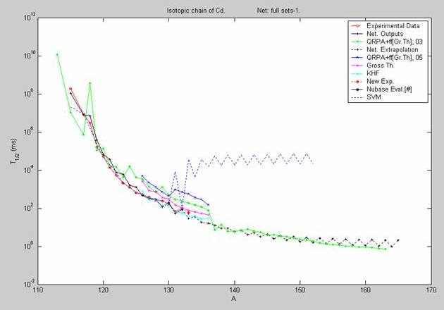
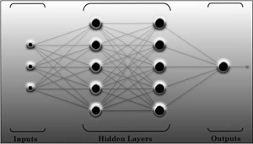
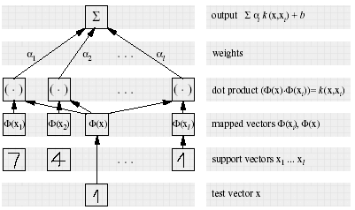
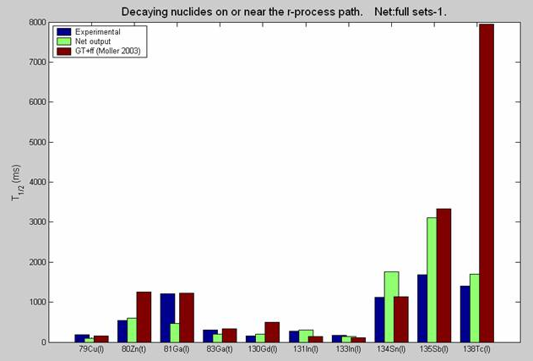

Statistical global modeling of β⁻-decay halflives systematics using Multilayer Feedforward Neural Networks and Support Vector Machines
N. J. Costiris,¹ E. Mavrommatis,¹ K. A. Gernoth,² J. W. Clark,³ and H. Li⁴
¹ Physics Department, Division of Nuclear Physics & Particle Physics, University of Athens, GR-15771 Athens, Greece
² Institut für Theoretische Physik, Johannes-Kepler-Universität, A-4040 Linz, Austria, and
School of Physics & Astronomy, Schuster Building, The University of Manchester, Manchester, M13 9PL, UK
³ McDonnell Center for the Space Sciences & Department of Physics, Washington University, St. Louis, MO 63130, USA,
Complexo Interdisciplinar, Centro de Mathemática e Aplicaҫões Fundamentals, University of Lisbon, 1649-003 Lisbon, Portugal, and
Departamento de Fίsica, Instituto Superior Técnico, Technical University of Lisbon, 1096 Lisbon, Portugal
⁴ Dartmouth Medical School, Lebanon, NH 03756, USA
N
U
M
B
E
R
S
R
U
L
E
T
H
E
U
N
I
V
E
R
S
E
Abstract
Reliable estimates of β⁻-decay halflives for nuclei far from stability are needed by the experimental exploration of the nuclear landscape at existing and future radioactive ion-beam facilities and by ongoing major efforts in astrophysics towards understanding of supernova explosions, and the processes of nucleosynthesis, notably the r-process.
A constellation of theory-driven, macroscopic or semi-microscopic models has been developed during the last decades for generating β⁻-decay halflives. However, the predictive power of these theory-thick models is rather limited. The recent advances in Artificial Intelligence (AI) algorithms and in statistical learning theory, present on the other hand the opportunity to develop statistical, data-driven models of quantum systems exhibiting remarkable predictive power [1-3].
In this work, the beta-decay halflives problem is dealt as a nonlinear optimization problem, which is resolved in the statistical framework of machine learning. Continuing past similar approaches [3], we construct more sophisticated Artificial Neural Network (NN) and Support Vector Regression Machine (SVRM) [2] methods to global model the systematics of nuclei that decay 100% by the β⁻ mode in their ground states. The arising large-scale lifetime calculations generated by both types of machines are discussed and compared with the available experimental data [4], with previous results obtained with neural networks [3], as well as with estimates coming from traditional global nuclear models. Particular attention is paid on the estimates for exotic and halo nuclei and we focus to those nuclides that are involved in the r-process nucleosynthesis. It seems that both NNs and SVRVs demonstrate similar performance and that our statistical, theory-thin, large-scale calculations can surpass the predictive performance of the best conventional global calculations.
Main Theory-Thick Global Models
Machine Learning Procedure
Fundamental Beta-Decay Question
GT
GT2
SGT
GT*
Machine learning statistical framework
To what extent do the nucleonic numbers determine the beta-decay halflife systematics of a nuclear system?
pn-QRPAs
NBCS + pnQRPA
target
(Log₁₀T_{β,exp})
Theory-
driven
Global
Models
Shell Model
FRDM + pnQRPA
Input
[Z, N]
Learning Machine:
Neural Network or
Support Vector
Regression Machine
Output
(Log₁₀T_{β,calc})
comparison
QRPA + ffGT
HFBCS + CQRPA
parameters adjustment
Figures - Comparisons
C-QRPAs
ETFSI+CQRPA
The central idea of machine learning is that free parameters can be adjusted by minimizing the so-called “cost function” through a proper training algorithm, so that the machine responds to a desired behavior.
R-QRPAs
Several models for determining β⁻ halflives have been proposed and applied over the years. One can mention the more phenomenological models based on Gross Theory (GT), as well as models that employ the pn Quasiparticle Random-Phase Approximation (pn-QRPA) (in various versions) or shell-model calculations. The latest hybrid version of the RPA models developed by Möller and coworkers, combines the pn-QRPA model with the statistical Gross Theory of ff-decay. There are also some models in which the ground state of the parent nucleus is described by the extended Thomas-Fermi plus Strutinsky integral method, the Hartree-Fock BCS, or other density functional method (DF) and which use the continuum QRPA (CQRPA). Recently relativistic pn-QRPA (RQRPA) models has been applied in the treatment of neutron-rich nuclei in the N~50, Ν~82 and Z~28 and 50 regions.
NN & SVRM Learning Machines
The subdivision of the sets in four parity classes can lead to spurious fluctuations. This favors the use of the NN model developed recently by means of the whole basis [1].
Artificial Neural Network Support Vector Regression
NNs are systems, consisting of interconnected dynamical units (neurons) that are typically arranged in a distinct layered topology.
The convergence with the experimental data for some nuclei on or close to a typical r-process path with the neutron separation energy lesser or equal to 3 MeV.
SVRMs, which belong to the class of kernel methods, are systems based on the statistical VC theory.
r-process Figure
Data Sets For Theory-Thin Modeling
Database | NuSet-B |  | Half-life Range | Decay Mode
NuBase2003 [4] | Cutoff | 10⁶ s | 0.15 x 10⁻² s → ³⁵Na 0.20 x 10⁶s → ²⁴⁷Pu | 100% β⁻
Results
References
Comparison with the experimental data
 | Learning Set |  | Validation Set |  | Test Set
Classes | N | RMSE | N | RMSE | N | RMSE
Current NN Calculation
EE | 131 | 0.36 | 16 | 0.41 | 16 | 0.62
EO | 179 | 0.38 | 22 | 0.44 | 22 | 0.39
OE | 172 | 0.44 | 21 | 0.46 | 21 | 0.53
OO | 190 | 0.52 | 24 | 0.42 | 24 | 0.33
Total | 672 | 0.41 | 83 | 0.44 | 83 | 0.51
(b) Current SVR Calculation [2]
EE | 131 | 0.55 | 16 | 0.57 | 16 | 0.62
EO | 179 | 0.41 | 22 | 0.42 | 22 | 0.51
OE | 172 | 0.41 | 21 | 0.47 | 21 | 0.47
OO | 190 | 0.52 | 24 | 0.40 | 24 | 0.52
Total | 672 | 0.47 | 83 | 0.46 | 83 | 0.53
(c) Previous NN Calculation [3]
Total | - | 1.08 | - | - | - | 1.82
[1] N.J. Costiris, E. Mavrommatis, K.A. Gernoth and J.W. Clark, in Proceedings of the 16th Hellenic Symposium of the Hellenic Nuclear Physics Society, (Athens, 2006) p. 210 (nucl-th/0701096); Phys. Rev. C, submitted.
[2] J.W. Clark and H. Li, Int.J.Mod.Phys. B20 (2006) 5015-5029 (nucl-th/0603037)
[3] E. Mavrommatis, A. Dakos, K.A.Gernoth and J.W. Clark, in Condensed Matter Theories, Vol. 13, edited by J. da Providencia and F. B. Malik (Nova Sciences Publishers, Commack, NY, 1998), p.423.
[4] G. Audi, O. Bersillon, J. Blachot and A.H. Wapstra, Nucl.Phys. A729 (2003) 3
NuSet-B consists of 838 nuclides: 672 (~80%) of them have been randomly chosen to train the machines (learning set), 83 (~10%) to validate the learning procedure (validation set) and the remaining 83 (~10%) to evaluate the accuracy of the prediction (test set).
Acknowledgements
This research has been supported in part by the U.S. National Science Foundation under Grant No. PHY-0140316 and by the University of Athens under Grant No.70/4/3309. We wish to thank G. Audi and his team for very helpful communications.
www.pythaim.phys.uoa.gr

